Slide 1
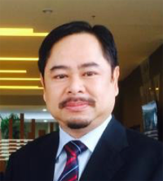
TIPS AND TECHNIQUE OF OBTAINING MULTIMEDIA RESOURCES OVER THE NET
Dr. Fakhrul Hazman Yusoff
fakhrul@uitm.edu.my

Slide 2
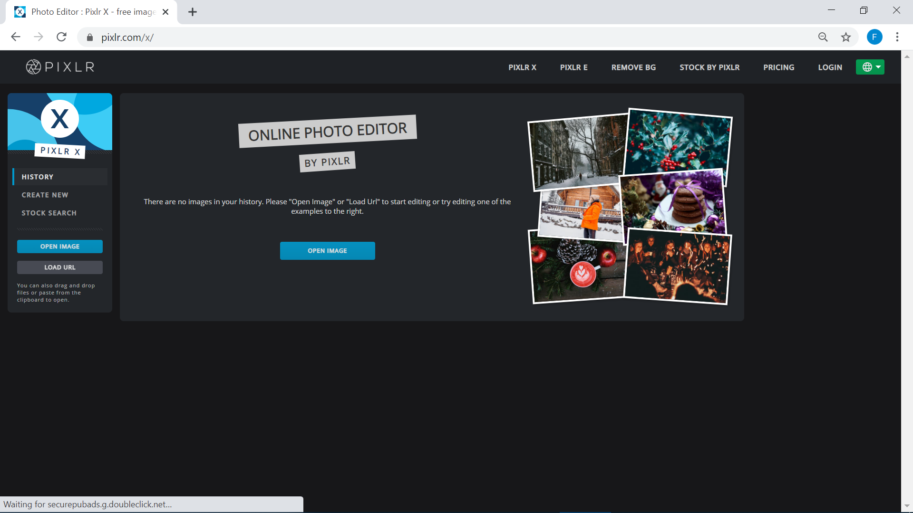
Pixlr as Photoshop Substitute
You can use https://pixlr.com/x/ to do instant editing.

Slide 3
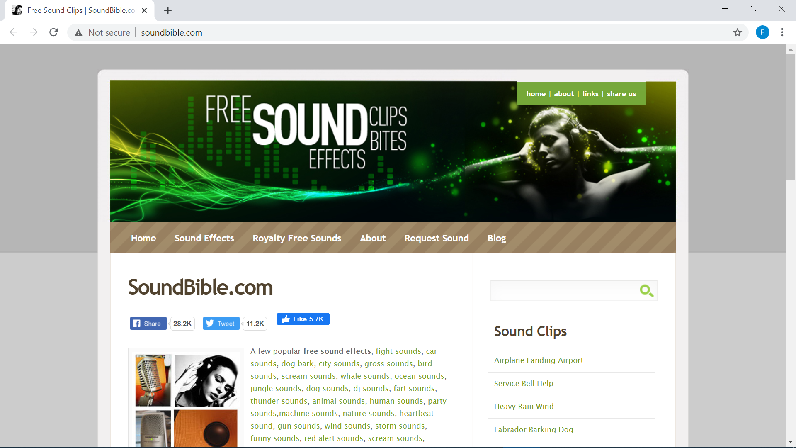
Need sounds? Visit http://soundbible.com/

Slide 4
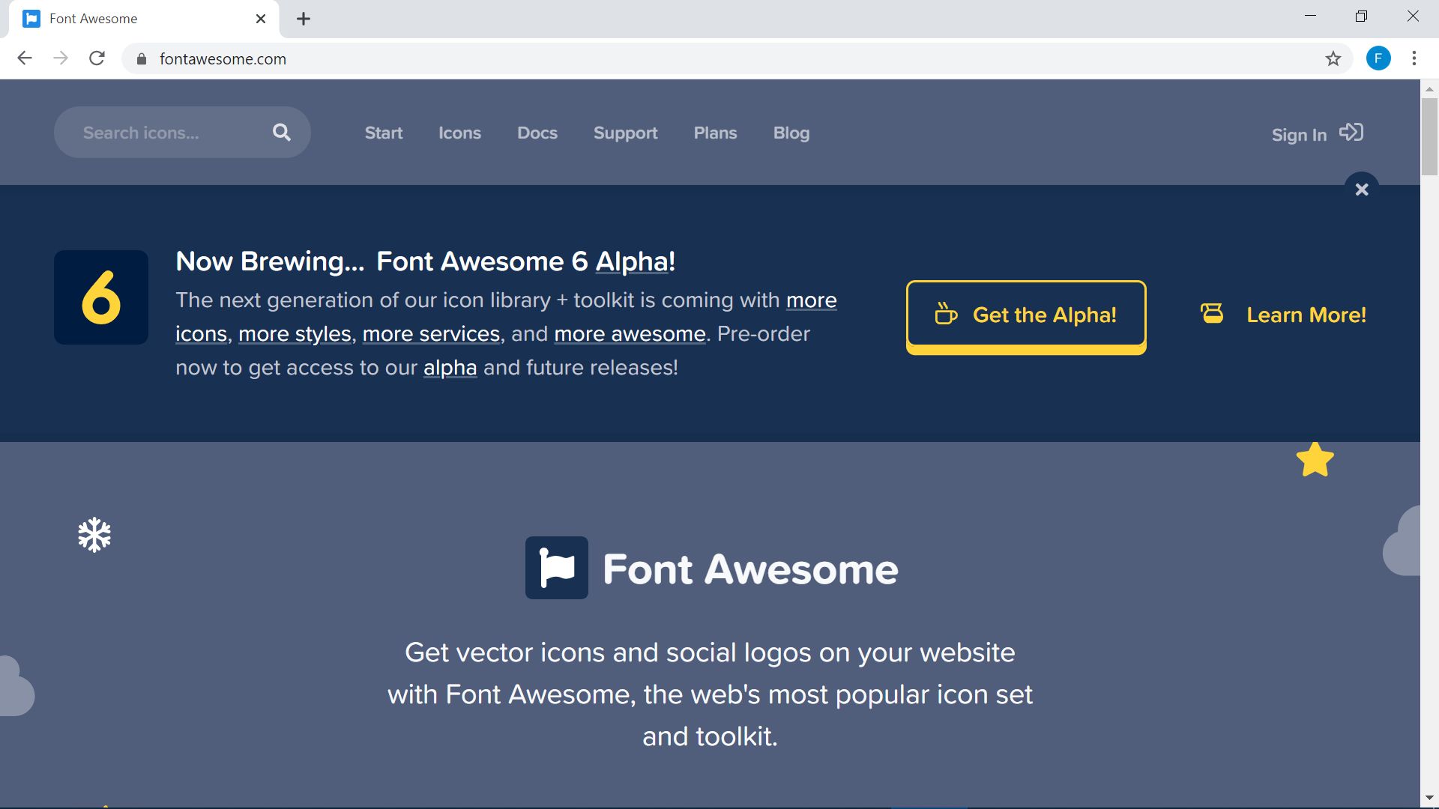
Font Awesome for your Webpage text/icon etc. https://fontawesome.com

Slide 5
Font Awesome example

Slide 6
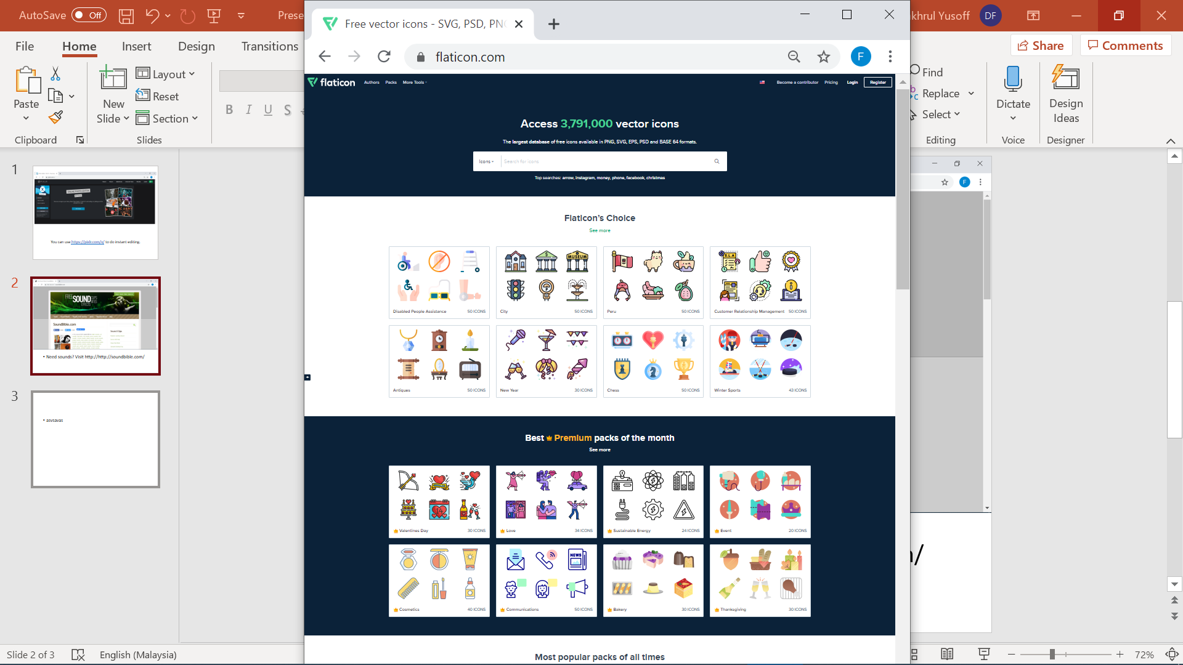
Head to https://flaticon.com for nice images of various format.

Slide 7
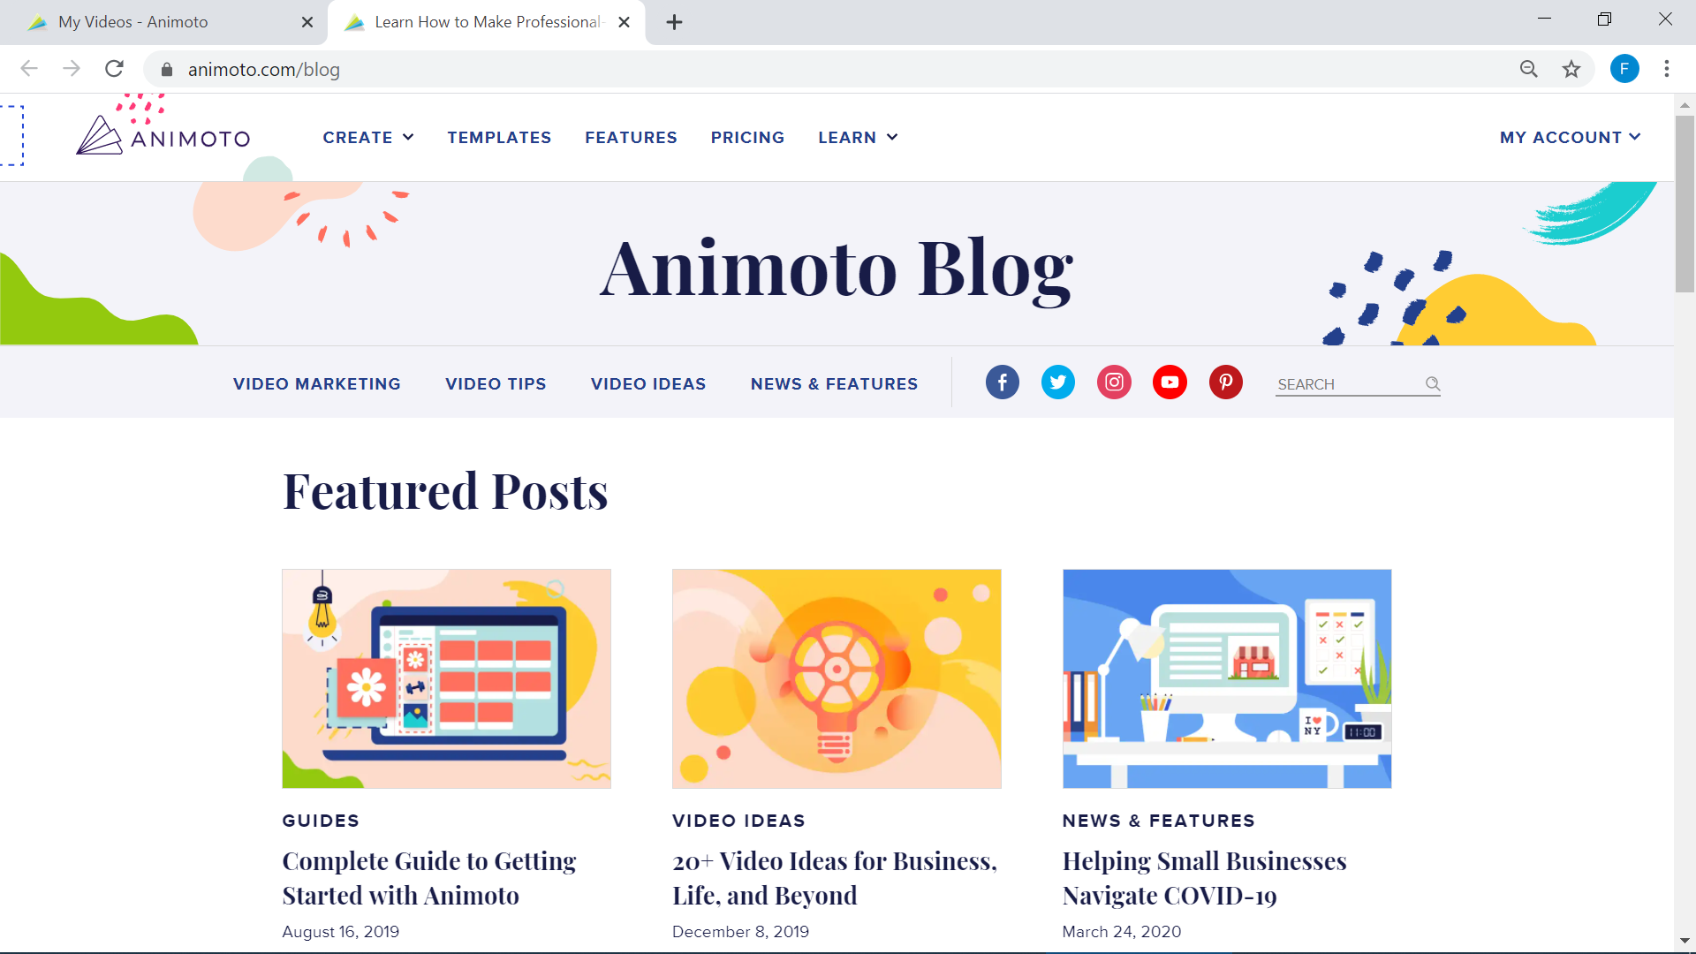
Video Montage? https://animoto.com

Slide 8
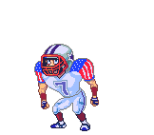
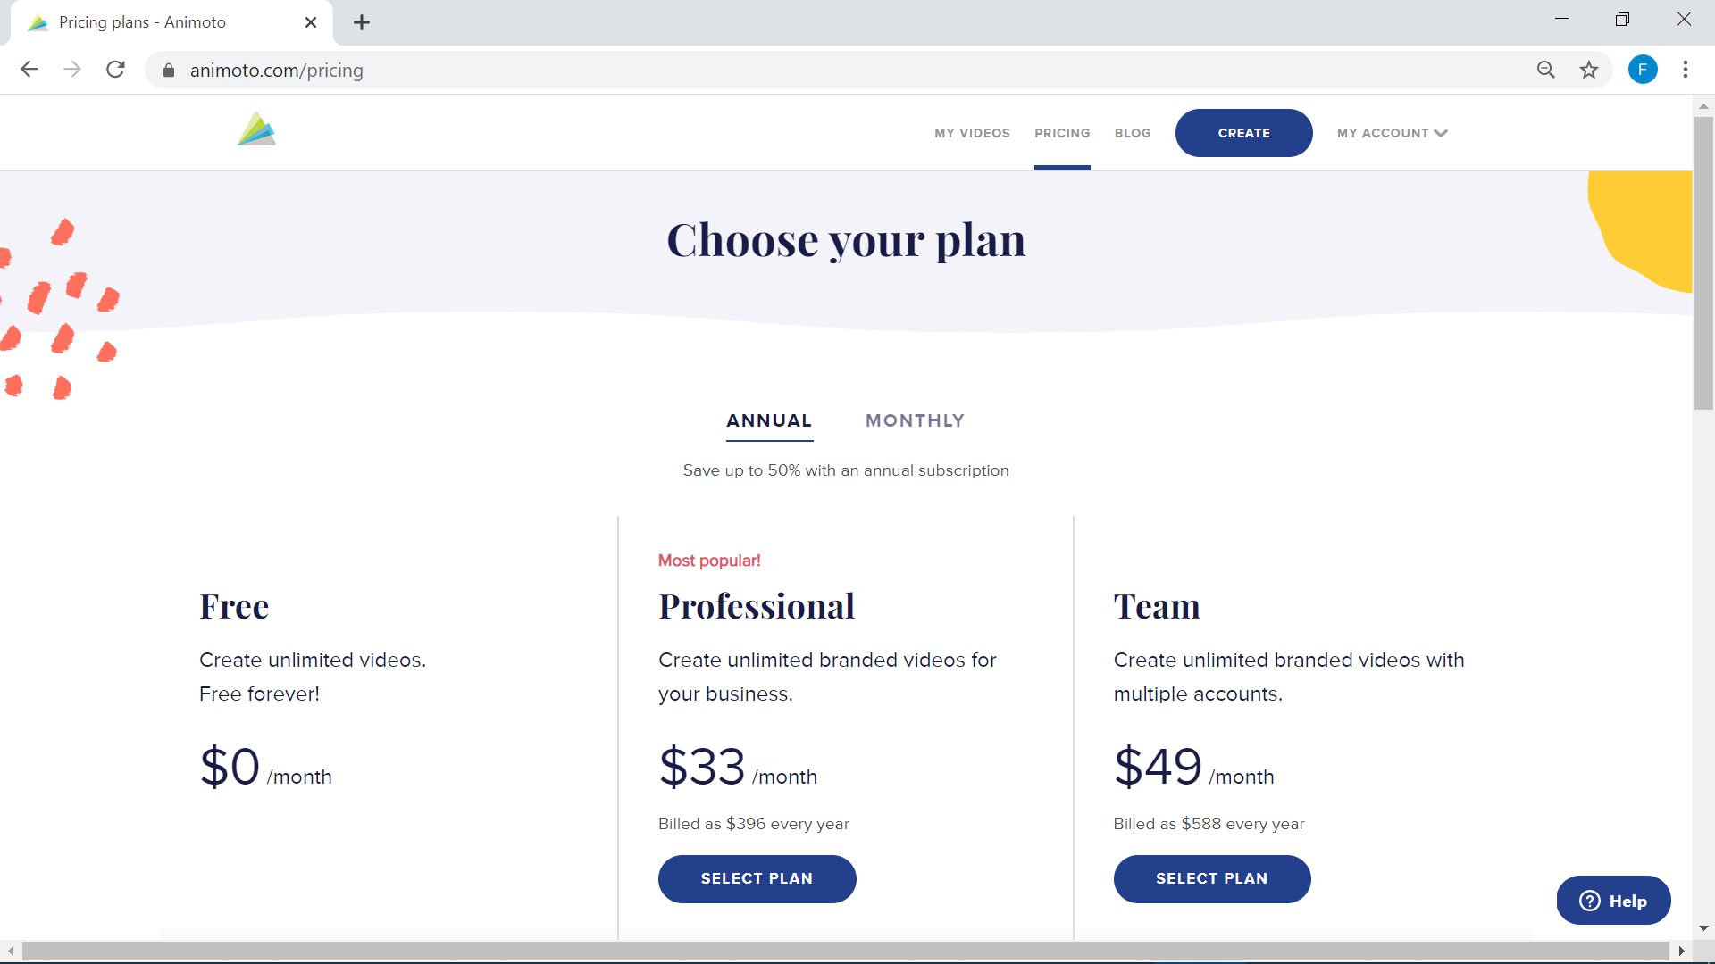
Video Montage? Animoto
https://animoto.com

Slide 9
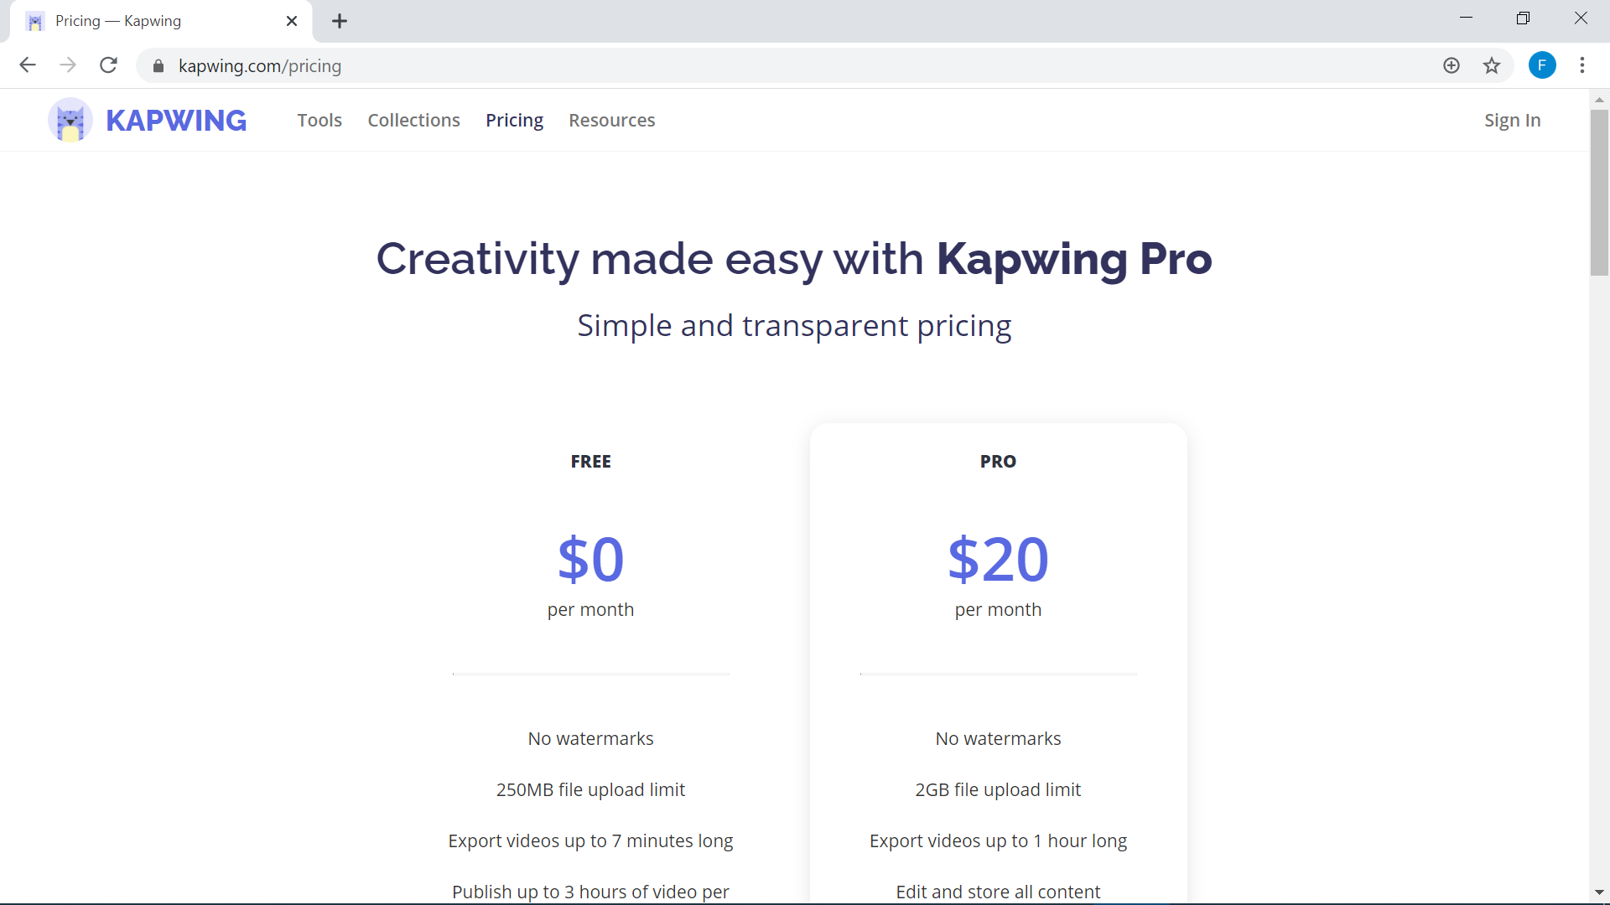
You can try KAPWING
https://kapwing.com

Slide 10
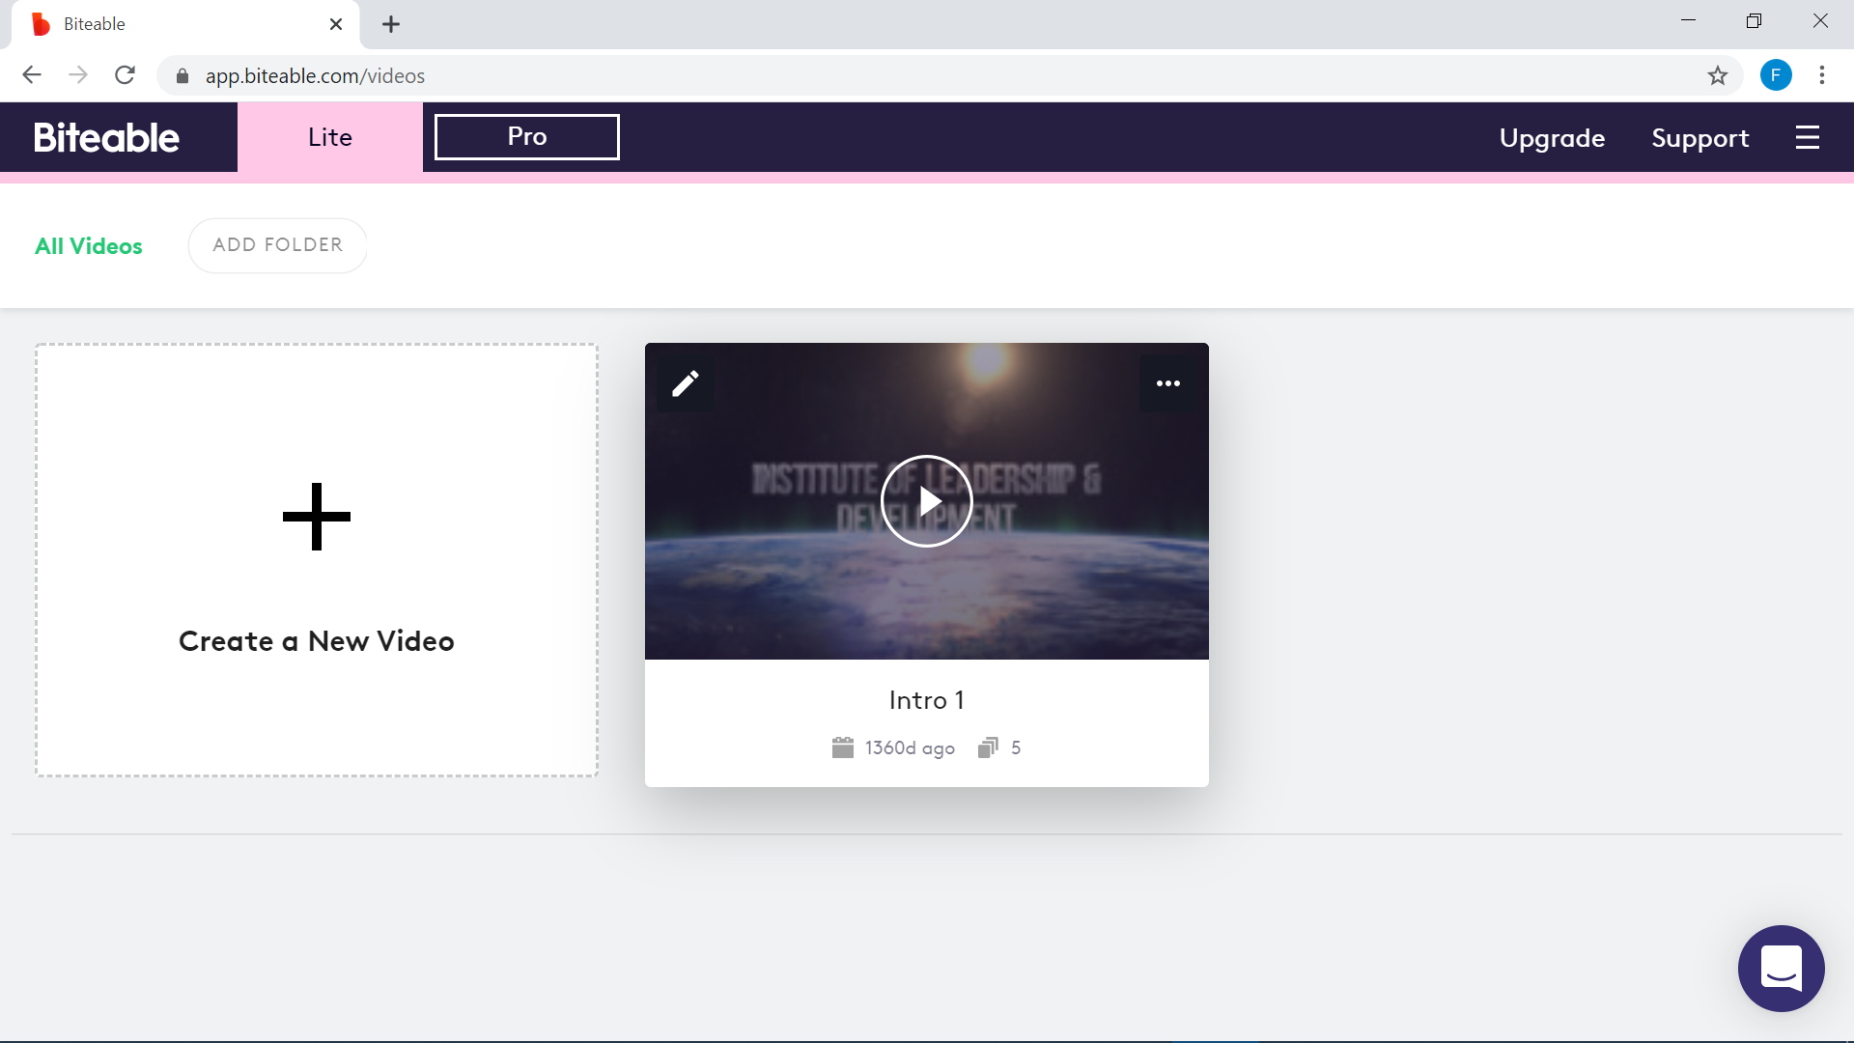
or you can try
https://app.biteable.com/

Slide 11
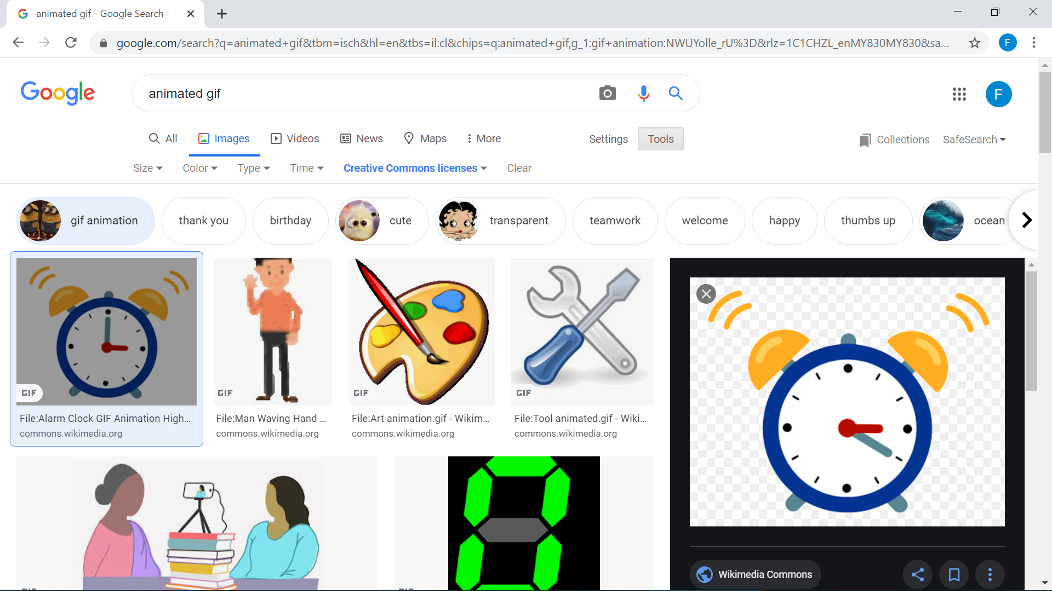
Google Search
You can always use Google as your resource.

Slide 12
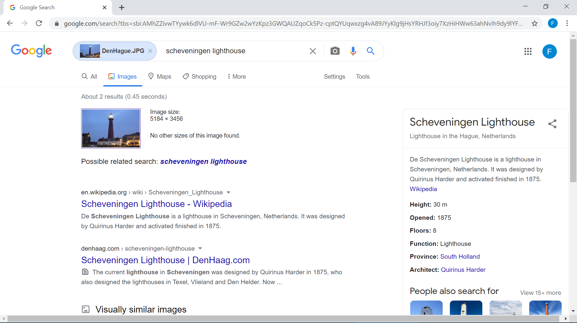
Google Search
It has image-based search feature

Slide 13
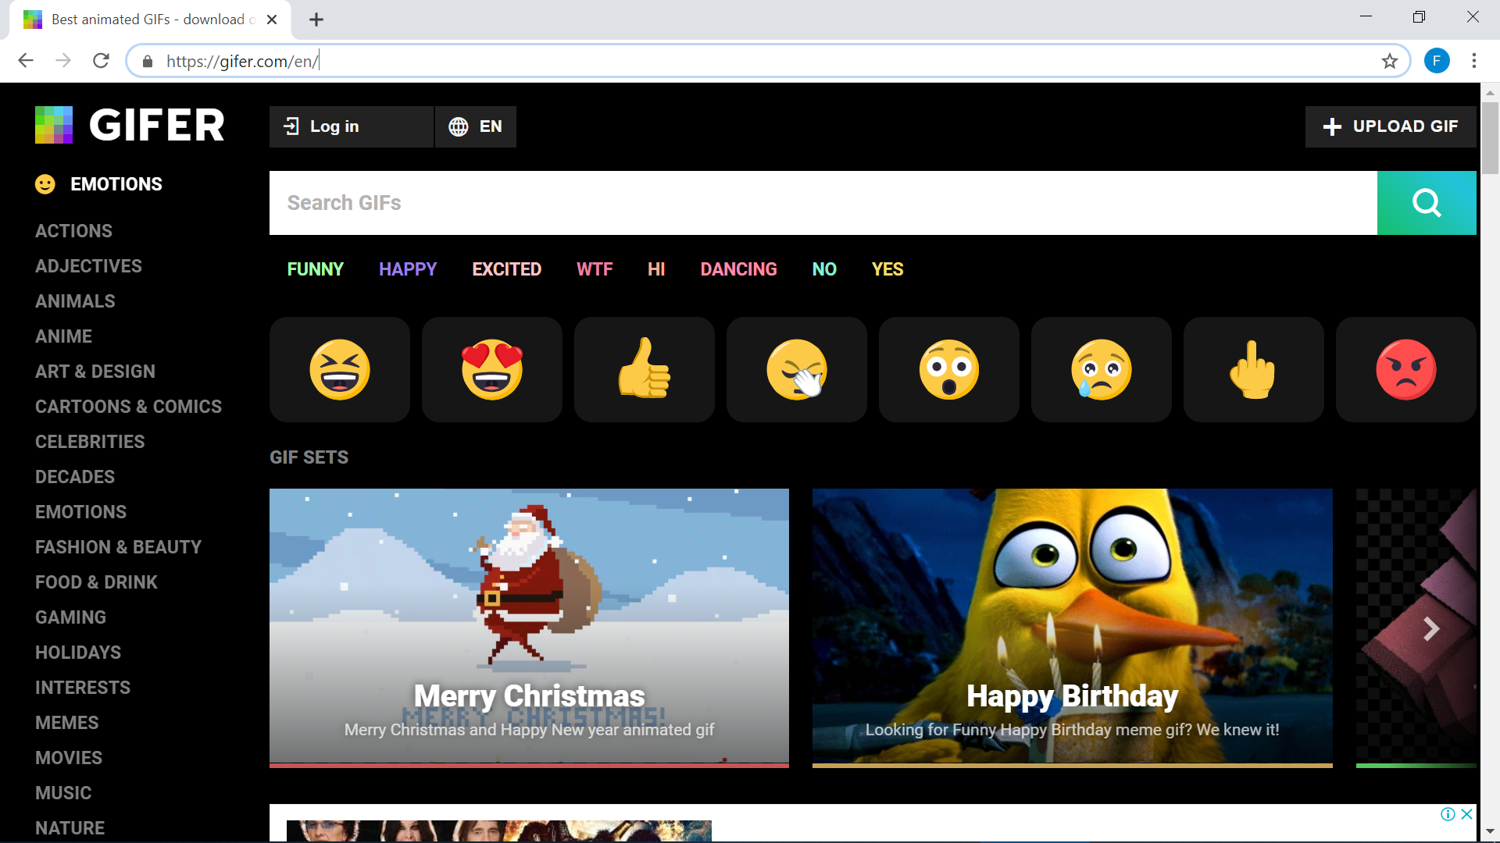
Animated Gifs https://gifer.com/en/

Slide 14
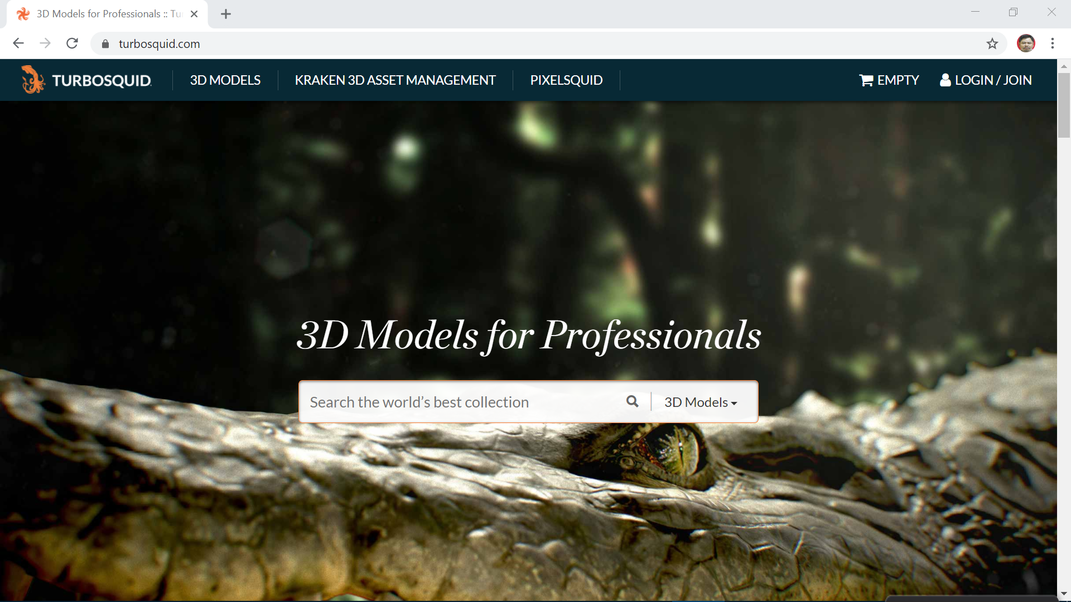
Other Place that I go to

Slide 15
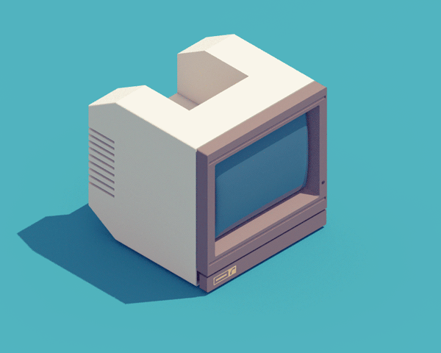
Thank You
Dr. Fakhrul Hazman Yusoff

